Slide 1
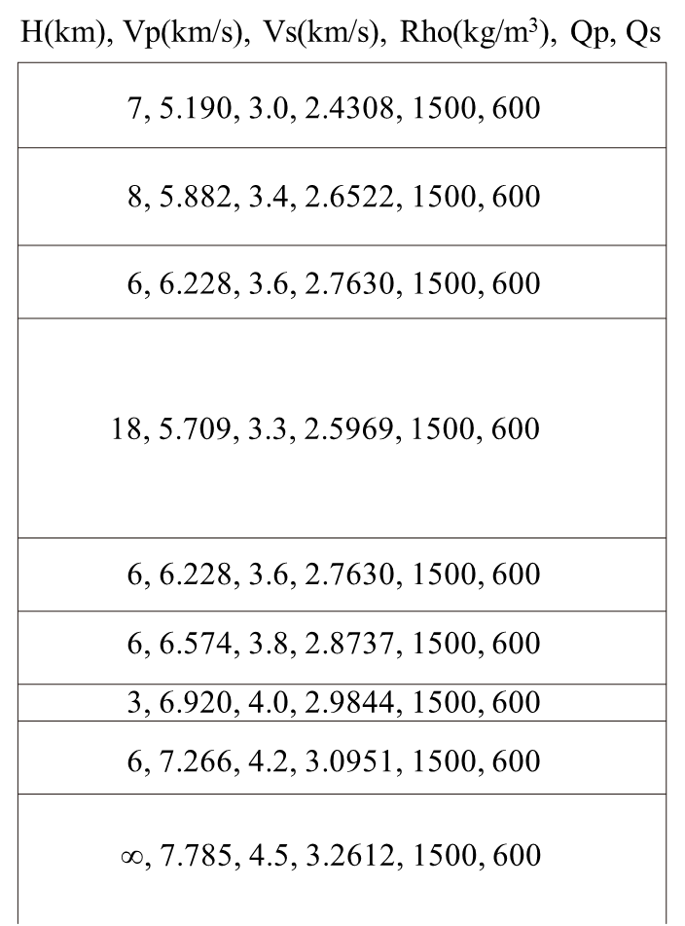
H(km), Vp(km/s), Vs(km/s), Rho(kg/m³), Qp, Qs
7, 5.190, 3.0, 2.4308, 1500, 600
8, 5.882, 3.4, 2.6522, 1500, 600
6, 6.228, 3.6, 2.7630, 1500, 600
18, 5.709, 3.3, 2.5969, 1500, 600
6, 6.228, 3.6, 2.7630, 1500, 600
6, 6.574, 3.8, 2.8737, 1500, 600
3, 6.920, 4.0, 2.9844, 1500, 600
6, 7.266, 4.2, 3.0951, 1500, 600
∞, 7.785, 4.5, 3.2612, 1500, 600

